Slide 1

CET1046B Object Oriented Concepts with C++ and Java

Slide 2
Templates and Standard Template Library (STL)
Templates: Function Template, Class Template.
Introduction to STL, Containers - Sequence Containers and Associative Containers, Container Adapters, Algorithms and Iterators - input, output, forward, bidirectional and random access.

Slide 3
Maximum of Two Numbers
Data Type
....
Integer
Double
Float
Long
int maximum(int a, int b)
{
if (a > b)
return a;
else
return b;
}
double maximum(double a, double b)
{
if (a > b)
return a;
else
return b;
}
float maximum(float a, float b)
{
if (a > b)
return a;
else
return b;
}
Notes:
To illustrate template functions, let’s look at this simple function. It would appear as part of a program that needs to find the larger of two integers. The function returns a copy of the larger of its two arguments.

Slide 4
A Template Function for Maximum
This template function can be used with many data types.
template <class T>
T maximum(T a, T b)
{
if (a > b)
return a;
else
return b;
}
Notes:
This is our first example of a template function. It is a single function that depends on an underlying data type that I’ve called Item. The actual Item type could be any of many different types: int, double, char--in fact any type that has two features: (1) the data values can be compared with the > operator, and (2) the data type has a copy constructor. (By the way, where is the copy constructor needed? It is needed to initialized the two parameters from their actual arguments, and also needed when the function returns a value.)
Anyway, let’s look at the pattern for converting an ordinary function to a template function...

Slide 5
Templates
Templates are a feature of the C++ programming language that allow functions and classes to operate with generic types. This allows a function or class to work on many different data types without being rewritten for each one.
Generic programming is about generalizing software components so that they can be easily reused in a wide variety of situations.
C++ uses templates to enable generic programming techniques.

Slide 6
C++ provides two kinds of templates
Function templates
Class templates

Slide 7
Sample Function Template to find absolute value
#include iostream
using namespace std;
//function template
template <class T>
T abs1(T n) {
return (n<0)? -n:n;
}
int main(){
int int1 = 5, int2 = -6;
long lon1 = 70000L, lon2 = -80000L;
double dub1 = 9.95, dub2 = -10.15;
cout << "\nabs(" << int1 << ")=" << abs1(int1); //abs(int)
cout << "\nabs(" << int2 << ")=" << abs1(int2); //abs(int)
cout << "\nabs(" << lon1 << ")=" << abs1(lon1); //abs(int)
cout << "\nabs(" << lon2 << ")=" << abs1(lon2); //abs(int)
cout << "\nabs(" << dub1 << ")=" << abs1(dub1); //abs(int)
cout << "\nabs(" << dub2 << ")=" << abs1(dub2); //abs(int)
abs(5)=5
abs(-6)=6
abs(70000)=70000
abs(-80000)=80000
abs(9.95)=9.95
abs(-10.15)=10.15
Notes:
Fundamentals of OOP: Class, Object, Data Abstraction, Data Encapsulation, Inheritance, Polymorphism.
Classes and Objects: Creation, Accessing Class Members, Access Specifiers, Member Function Definition, Inline Function, Static Data Members, Function Overloading, Constructor and Destructor, Objects and Memory Requirements, Friend Functions.

Slide 8
Function Template to find maximum of 2 numbers
#include<iostream>
using namespace std;
template<class T>
void max1(T x, T y) // T represent generic data type
{
if(x>y)
cout<<x<<"is greater"<<endl;
else
cout<<y<<"is greater"<<endl;
}
int main()
{
max1(3,7);
max1(44.66,55.66);
return 0;
}
Output:
7 is greater
55.56 is greater
Notes:
Fundamentals of OOP: Class, Object, Data Abstraction, Data Encapsulation, Inheritance, Polymorphism.
Classes and Objects: Creation, Accessing Class Members, Access Specifiers, Member Function Definition, Inline Function, Static Data Members, Function Overloading, Constructor and Destructor, Objects and Memory Requirements, Friend Functions.

Slide 9
Finding the Maximum Item in an Array
A function that can be made more general by changing it to a template function:
int array_max(int data[ ], int n)
{
int i;
int answer;
answer = data[0];
for (i = 1; i < n; i++)
if (data[i] > answer)
answer = data[i];
return answer;
}
template <class Item>
Item array_max(Item data[ ], int n)
{
int i;
Item answer;
assert(n > 0);
answer = data[0];
for (i = 1; i < n; i++)
if (data[i] > answer)
answer = data[i];
return answer;
}
int main(){
int array[]={5,4,6,2,1},ians;
double array1[]={2.3,4.3,1.1,6.7},dans;
ians=array_max(array,5);
cout<<"max from int array is"<<ians;
dans=array_max(array1,4);
cout<<"max from double array is"<<dans;
return 0;
}
Notes:
Here’s another function that can be improved by making it into a template function. In this form, the function can find the largest integer in an array of integers. But it can’t be used for an array of double numbers, or an array of some other kind of objects.
In this case, the function depends on the underlying data type of the components of the array. We can call this component type Item, and rewrite the function as a template function...

Slide 10
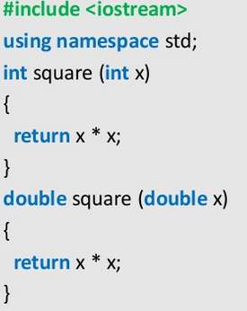
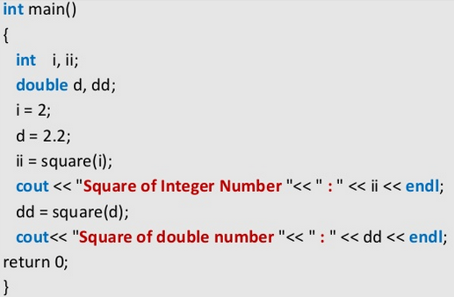
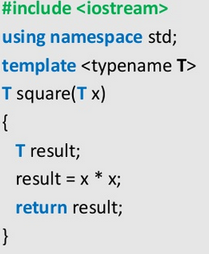
Function Overloading Vs Function Template

Slide 11
Ex
Write a generic function that swaps values in two variables. Function should have two parameters of the same type. Test the function with integer and double values.

Slide 12
Solution of Ex
#include <iostream>
using namespace std;
template <typename X>
void swapargs(X *a, X *b){
X temp;
temp = *a;
*a = *b;
*b = temp;
}
int main(){
int i=10, j=20; float x=10.1, y=23.3;
cout << "Original i, j: " << i << ' ' << j << endl; cout << "Original x, y: " << x << ' ' << y << endl;
swapargs(&i,&j); // swap integers swapargs(&x,&y); // swap floats
cout << "Swapped i, j: " << i << ' ' << j << endl; cout << "Swapped x, y: " << x << ' ' << y << endl; return 0;
}

Slide 13
Class Template
It represent various similar classes operating on data of different types.
Syntax:
template<class T>
Class class_name
{
Class members
}

Slide 14
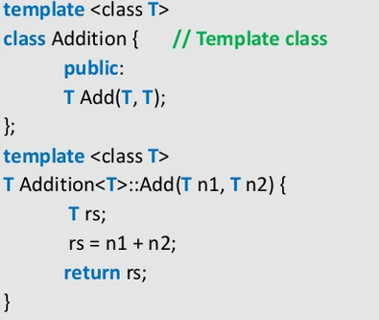
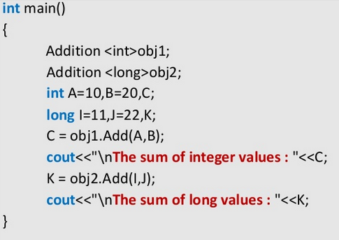
Class template Example 1 - Adding 2 numbers
The sum of integer values: 30
The sum of long values: 33

Slide 15
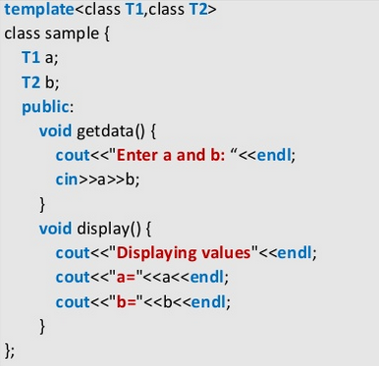
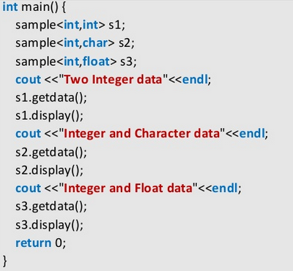
Class template Example 2-Display arguments

Slide 16
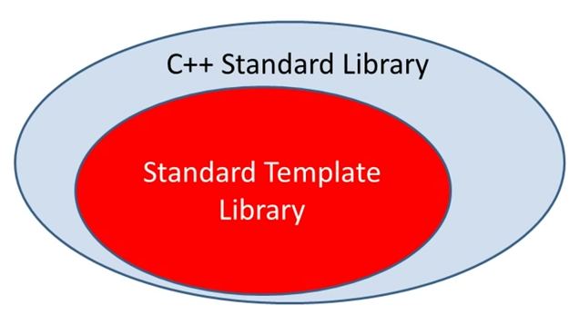
STL-Standard Template Library
The Standard Template Library (STL) is a set of C++ template classes to provide common programming data structures and functions such as lists, stacks, arrays, etc. It is a library of container classes, algorithms and iterators. It is a generalized library and so, its components are parameterized.
Collection of useful classes for common data structure
Ability to store objects of any type (template)
STL has four components
Algorithms
Containers
Functions
Iterators

Slide 17
Why to use STL?
It offers an assortment of containers
Publicizes the time and storage complexity of its containers
Containers grow and shrink in size automatically
Provides built-in algorithms for processing containers
Provides iterators that make the containers and algorithms flexible and efficient.
It is extensible which means that users can add new containers and new algorithms such that:
STL algorithms can process STL containers as well as user defined containers
User defined algorithms can process STL containers as well user defined containers

Slide 18
Standard Template Library
The STL-Standard Template Library contains:
Containers
Algorithms
Iterators
A container is a way that stored data is organized in memory , for example an array of elements.
Algorithms in the STL are producers that are applied to containers to process their data for example search for an element in an array or sort an array.
Iterators are a generalization of the concept of pointers they point to elements in a container for example you can increment an iterator to point to the next element in an array.

Slide 19
Component of STL
Containers
A container is a holder object that stores a collection other objects (its elements). They are implemented as class templates, which allows a great flexibility in the types supported as elements.
Iterators
They are a generalization of pointers: they are objects that point to other objects. As the name suggests, iterators are often used to iterate over a range of objects: if an iterator points to one element in a range, then it is possible to increment it so that it points to the next element.
Algorithms
The header <algorithm> defines a collection of functions especially designed to be used on ranges of elements.

Slide 20
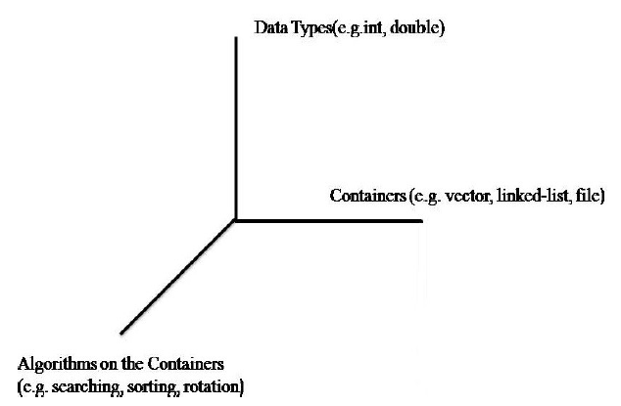
Component of STL
Containers: template data structures.
Containers hold data
Iterators: like pointers, access elements of containers
Iterators access data
Algorithms: data manipulation, searching, sorting, etc.
Algorithms, function objects manipulate data

Slide 21
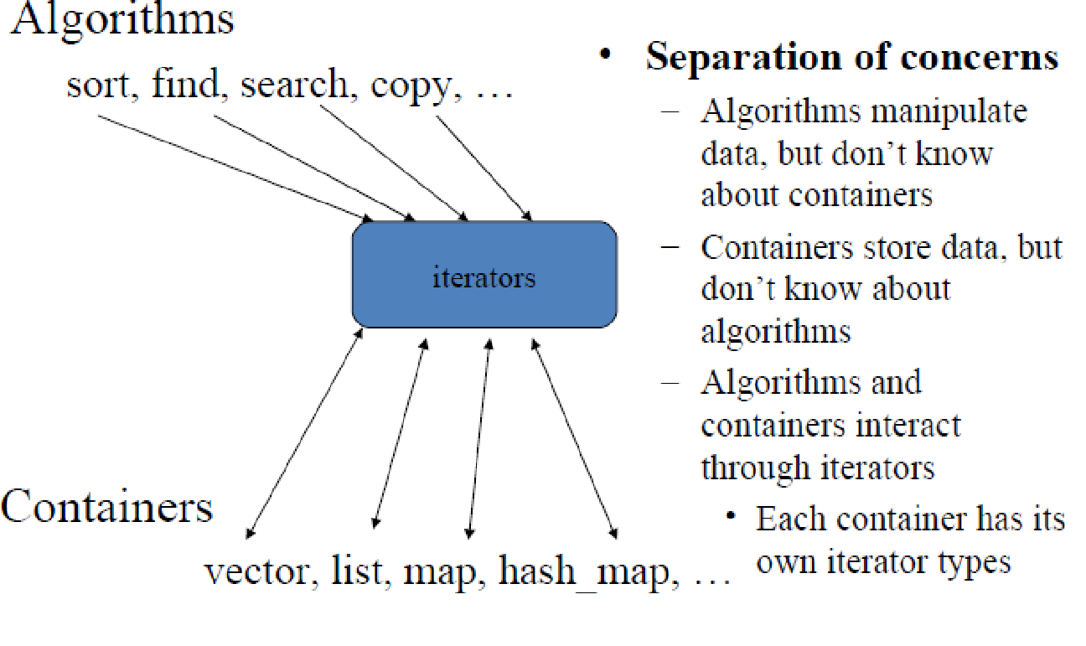
Component of STL

Slide 22
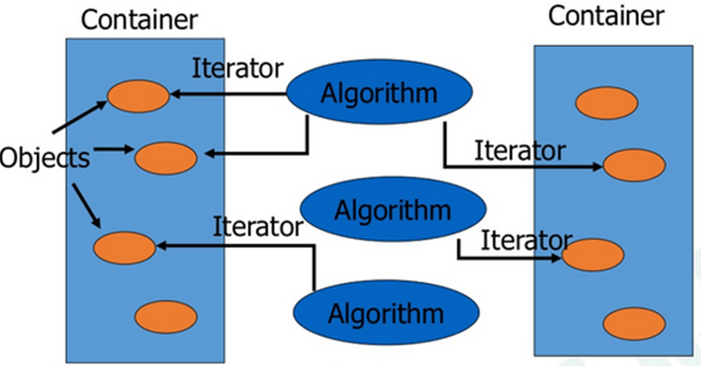
Standard Template Library

Slide 23
Container
A container is a way to store data, either built-in data types like int and float or class objects .
Containers or container classes store objects and data. There are in total seven standard “first-class” container classes and three container adaptor classes and only seven header files that provide access to these containers or container adaptors.

Slide 24
Types of Containers
Sequence Containers: implement data structures which can be accessed in a sequential manner.
Vector
List
Deque
Container Adaptors : provide a different interface for sequential containers.
Queue
Priority Queue
Stack
Associative Containers : implement sorted data structures that can be quickly searched
Set - Multiset
Map - Multimap

Slide 25
Vector – Sequence Container
Defining a new vector
Header file: <vector>
Syntax: vector <int> vec
Keyword
Data Type
Object

Slide 26
Vector - Operations
size()
-provides the number of elements
push_front() & push_back()
-appends an element at the front and end
pop_front() & pop_back()
-Erases the last element
begin()
-Provides reference to last element
end()
-Provides reference to end of vector

Slide 27
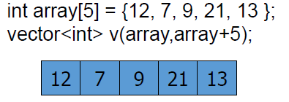
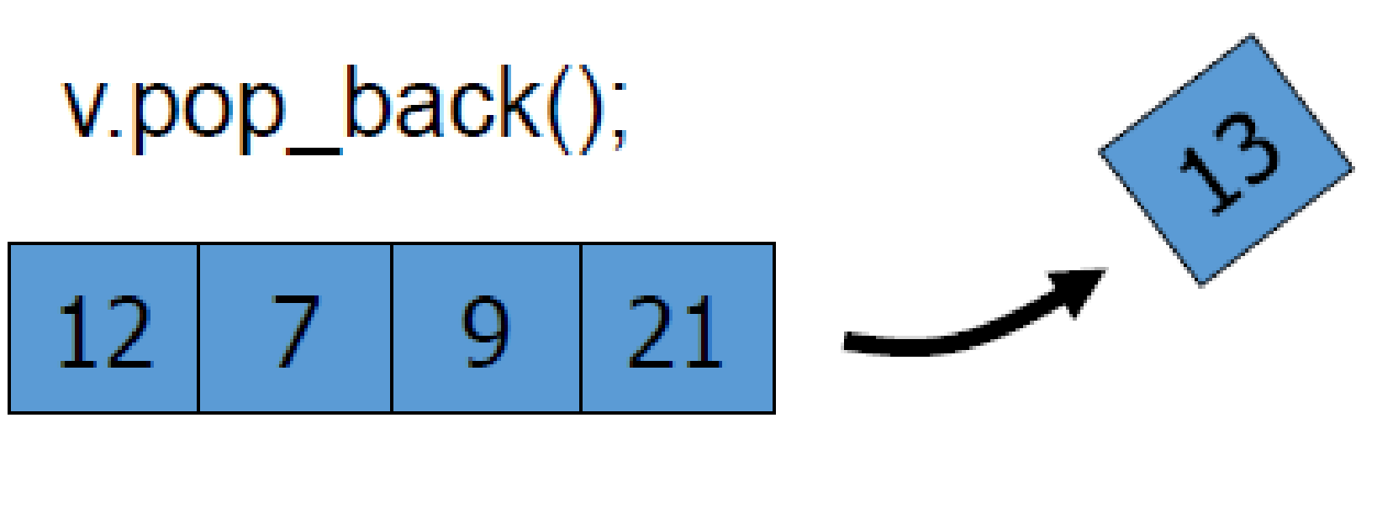
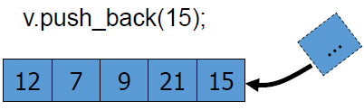
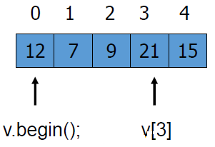
Vector Container

Slide 28
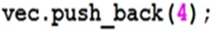
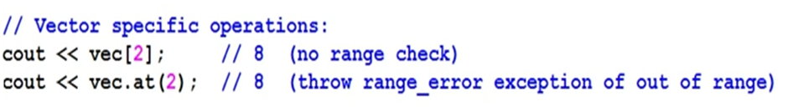
Vector
4
4 | 1
4 | 1 | 8

Slide 29
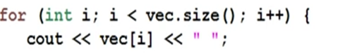
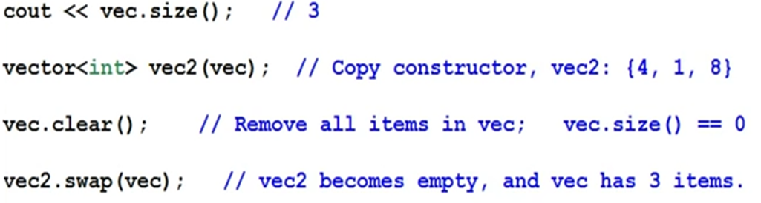
Vector container using stack
Output: “4 1 8”
Notes:
Fundamentals of OOP: Class, Object, Data Abstraction, Data Encapsulation, Inheritance, Polymorphism.
Classes and Objects: Creation, Accessing Class Members, Access Specifiers, Member Function Definition, Inline Function, Static Data Members, Function Overloading, Constructor and Destructor, Objects and Memory Requirements, Friend Functions.

Slide 30
Vector- Member Functions push_back(), size(), and operator[]
#include <vector>
using namespace std;
int main()
{
vector<int> v; //create a vector of ints
v.push_back(10); //put values at end of array
v.push_back(11);
v.push_back(12);
v.push_back(13);
v[0] = 20; //replace with new values
v[3] = 23;
for(int j=0; j<v.size(); j++) //display vector contents
cout << v[j] << ‘ ‘; //20 11 12 23
cout << endl;
return 0;
}

Slide 31
Vector- Member Functions swap(), empty(), back(), and pop_back()
#include <vector>
using namespace std;
int main()
{ //an array of doubles
double arr[] = { 1.1, 2.2, 3.3, 4.4 };
vector<double> v1(arr, arr+4); //initialize vector to array
vector<double> v2(4); //empty vector of size 4
v1.swap(v2); //swap contents of v1 and v2
while( !v2.empty() ) //until vector is empty,
{
cout << v2.back() << ‘ ‘; //display the last element
v2.pop_back(); //remove the last element
} //output: 4.4 3.3 2.2 1.1
cout << endl;
return 0;
}

Slide 32
Vector- Member Functions insert() and erase()
#include <iostream>
#include <vector>
using namespace std;
int main(){
int arr[] = { 100, 110, 120, 130 }; //an array of ints
vector<int> v(arr, arr+4); //initialize vector to array
cout << “\nBefore insertion: “;
for(int j=0; j<v.size(); j++) //display all elements
cout << v[j] << ‘ ‘;
v.insert( v.begin()+2, 115); //insert 115 at element 2
cout << “\nAfter insertion: “;
for(j=0; j<v.size(); j++) //display all elements
cout << v[j] << ‘ ‘;
v.erase( v.begin()+2 ); //erase element 2
cout << “\nAfter erasure: “;
for(j=0; j<v.size(); j++) //display all elements
cout << v[j] << ‘ ‘;
return 0;
}

Slide 33
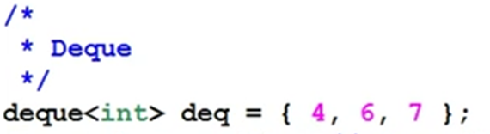
Deque
 | 4 | 6 | 7
 | 2 | 4 | 6 | 7 | 3
 | 2 | 4 | 6 | 7

Slide 34
Dequeue
#include <iostream>
#include <deque>
using namespace std;
int main()
{
deque<int> deq;
deq.push_back(30); //push items on back
deq.push_back(40);
deq.push_back(50);
deq.push_front(20); //push items on front
deq.push_front(10);
deq[2] = 33; //change middle item
for(int j=0; j<deq.size(); j++)
cout << deq[j] << ‘ ‘; //display items
cout << endl;
return 0;
}

Slide 35
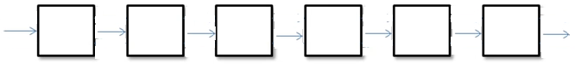
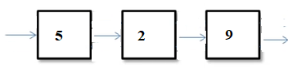
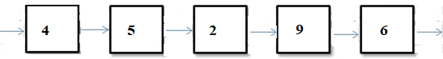
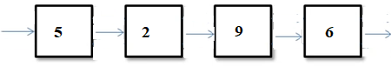
List

Slide 36
Member Functions push_front(), front(), and pop_front
#include <iostream>
#include <list>
using namespace std;
int main()
{
list<int> ilist;
ilist.push_back(30); //push items on back
ilist.push_back(40);
ilist.push_front(20); //push items on front
ilist.push_front(10);
int size = ilist.size(); //number of items
for(int j=0; j<size; j++)
{
cout << ilist.front() << ‘ ‘; //read item from front
ilist.pop_front(); //pop item off front } cout << endl; return 0;
}

Slide 37
Member Functions reverse(), merge(), and unique()
#include <iostream>
#include <list>
using namespace std;
int main(){
int j;
list<int> list1, list2;
int arr1[] = { 40, 30, 20, 10 };
int arr2[] = { 15, 20, 25, 30, 35 }
for(j=0; j<4; j++)
list1.push_back( arr1[j] ); //list1: 40, 30, 20, 10
for(j=0; j<5; j++)
list2.push_back( arr2[j] ); //list2: 15, 20, 25, 30, 35
list1.reverse(); //reverse list1: 10 20 30 40
list1.merge(list2); //merge list2 into list1
list1.unique(); //remove duplicate 20 and 30
int size = list1.size();
while( !list1.empty() )
{
cout << list1.front() << ‘ ‘; //read item from front
list1.pop_front(); //pop item off front
}
cout << endl;
return 0;
}

Slide 38
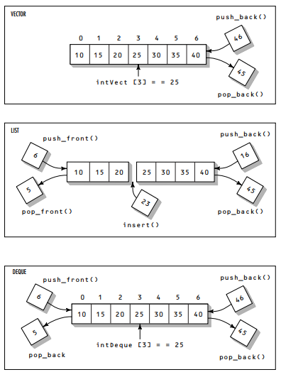

Slide 39
Stack
#include<stack>
#include<iostream>
using namespace std
int main()
{
stack <int> s
int ch,elem;
cout<<“push”<<“pop”
cin>>ch;
swicth(ch)
{
case 1:cout<<“enter element:”
cin>>elem;
s.push(elem);
break;
case 2: if(!stack.empty())
{
cout<<stack.top();
s.pop();
}
else
cout<<“\n stack empty:”
}
}

Slide 40
Iterators
Iterators are pointer-like entities that are used to access individual data items (which are usually called elements), in a container.
Often they are used to move sequentially from element to element, a process called iterating through the container.
can increment iterators with the ++ operator so they point to the next element, and dereference them with the * operator to
obtain the value of the element they point to.
In the STL an iterator is represented by an object of an iterator class.
Different classes of iterators must be used with different types of container.
There are three major classes of iterators: forward, bidirectional, and random access.

Slide 41
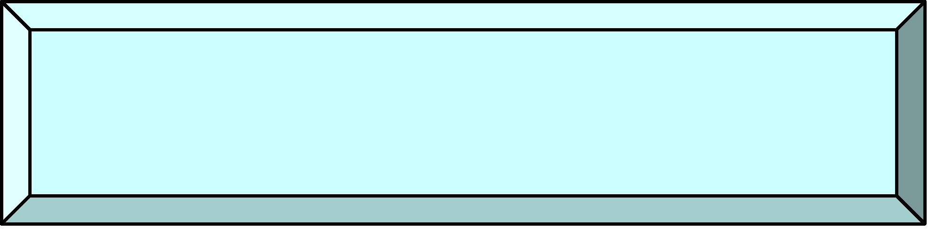
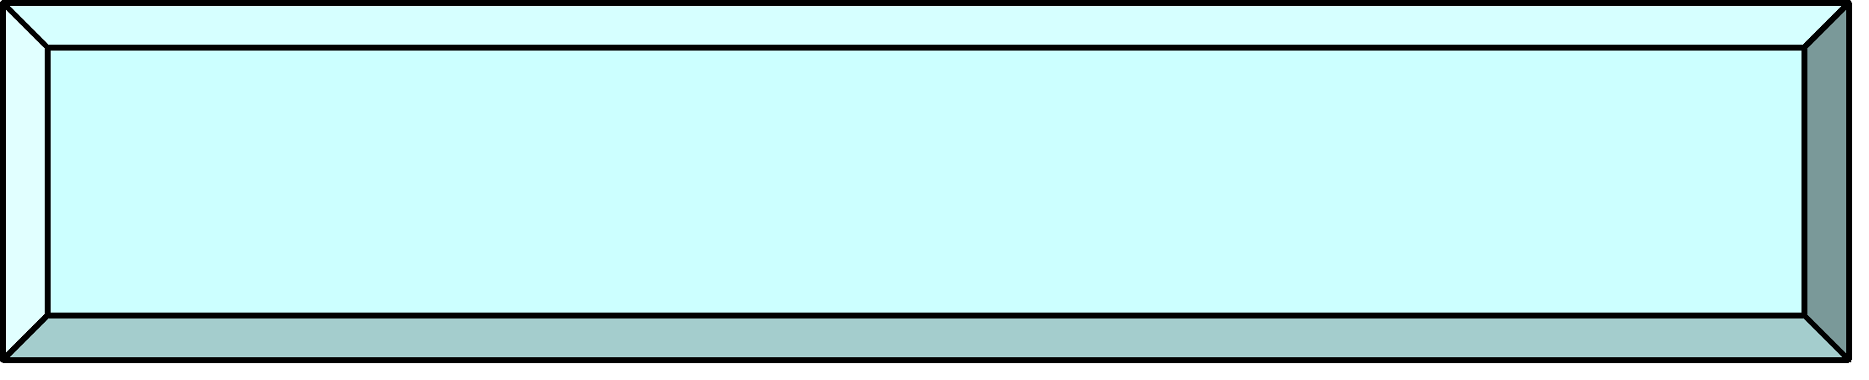
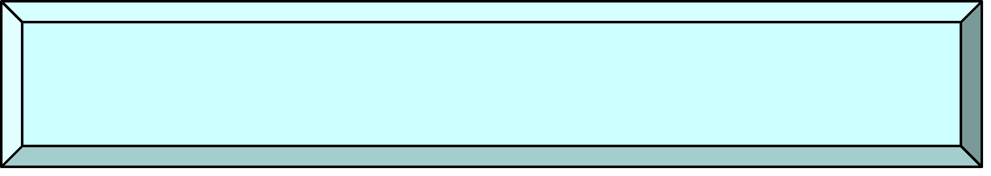
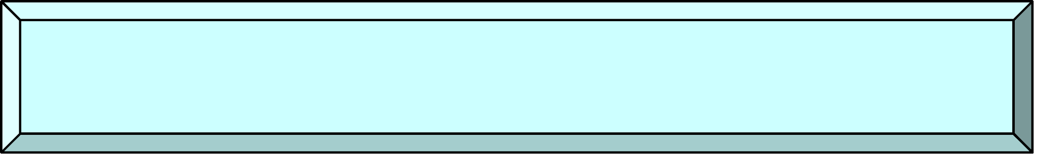
Iterators
++, input
++, output
Input Iterator
Output Iterator
++, I/O
Forward Iterator
++, --, I/O
Bi-directional Iterator
Pointer
arithmetic
Random-Access Iterator

Slide 42
Types of iterators
A forward iterator can only move forward through the container, one item at a time. Its ++ operator accomplishes this. It can’t move backward and it can’t be set to an arbitrary location in the middle of the container.
A bidirectional iterator can move backward as well as forward, so both its ++ and -- operators are defined.
A random access iterator, in addition to moving backward and forward, can jump to an arbitrary location. You can tell it to access location 27, for example.
There are also two specialized kinds of iterators.
An input iterator can “point to” an input device (cin or a file) to read sequential data items into a container, and
an output iterator can “point to” an output device (cout or a file) and write elements from a container to the device.
While the values of forward, bi-directional, and random access iterators can be stored (so they can be used later), the values of input and output iterators cannot be.
first three iterators point to memory locations, while input and output iterators point to I/O devices for which stored “pointer” values have no meaning.

Slide 43
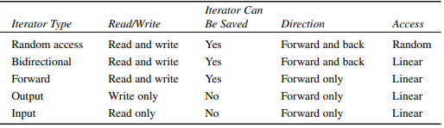
Iterator Characteristics

Slide 44
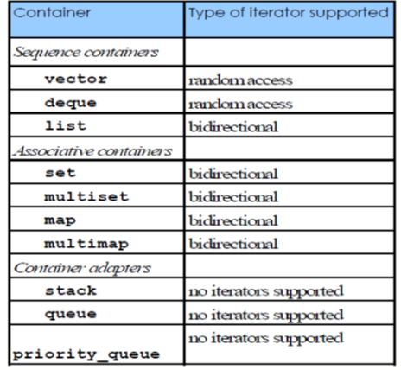
Iterators

Slide 45
Vector –Sequence Container
4
4 | 1
4 | 1 | 8

Slide 46
Vector container using iterator
Output: “4 1 8”
vector<int> vec;
vector<int>::iterator it;
cout << “Vector contains:";
for (it=vec.begin(); it!=vec.end(); ++it)
cout << ' ' << *it;
Output: “4 1 8”
Notes:
Fundamentals of OOP: Class, Object, Data Abstraction, Data Encapsulation, Inheritance, Polymorphism.
Classes and Objects: Creation, Accessing Class Members, Access Specifiers, Member Function Definition, Inline Function, Static Data Members, Function Overloading, Constructor and Destructor, Objects and Memory Requirements, Friend Functions.

Slide 47
Algorithms
The Standard Template Library provides a number of useful, generic algorithms to perform the most commonly used operations on groups/sequences of elements. These operations include traversals, searching, sorting and insertion/removal of elements.
The way that these algorithms are implemented is closely related to the idea of the containers and iterators, although, as we will see, they can be used with standard arrays and pointers.

Slide 48
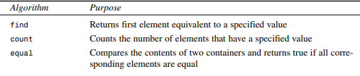
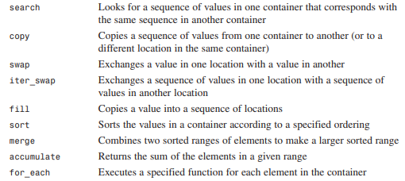
Algorithms
STL algorithms are not member functions or friends of containers. They are standalone template functions. To have access to the STL algorithms, we must include <algorithm> in our program.

Slide 49
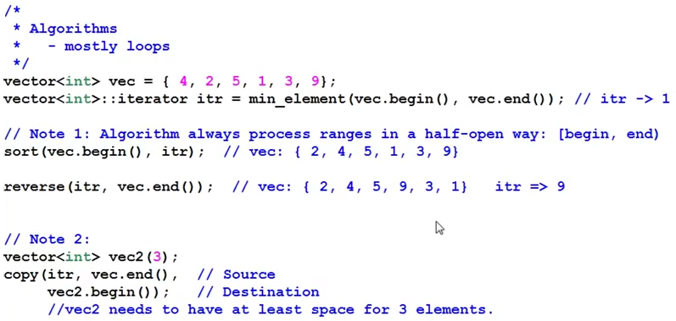
Algorithms

Slide 50
The find() Algorithm
#include <iostream>
#include <algorithm> //for find()
using namespace std;
int arr[] = { 11, 22, 33, 44, 55, 66, 77, 88 };
int main()
{
int* ptr;
ptr = find(arr, arr+8, 33); //find first 33
cout << “First object with value 33 found at offset “<< (ptr-arr) << endl;
return 0;
}

Slide 51
The count() Algorithm
#include <iostream>
#include <algorithm> //for count()
using namespace std;
int arr[] = { 33, 22, 33, 44, 33, 55, 66, 77 };
int main()
{
int n = count(arr, arr+8, 33); //count number of 33’s
cout << “There are “ << n << “ 33’s in arr.” << endl;
return 0;
}

Slide 52
The sort() Algorithm
#include <iostream>
#include <algorithm>
using namespace std;
//array of numbers
int arr[] = {45, 2, 22, -17, 0, -30, 25, 55};
int main()
{
sort(arr, arr+8); //sort the numbers
for(int j=0; j<8; j++) //display sorted array
cout << arr[j] << ‘ ‘;
cout << endl;
return 0;
}

Slide 53
The search() Algorithm
#include <iostream>
#include <algorithm>
using namespace std;
int source[] = { 11, 44, 33, 11, 22, 33, 11, 22, 44 };
int pattern[] = { 11, 22, 33 };
int main()
{
int* ptr;
ptr = search(source, source+9, pattern, pattern+3)
if(ptr == source+9) //if past-the-end
cout << “No match found\n”;
else
cout << “Match at “ << (ptr - source) << endl;
return 0;
}

Slide 54
The merge() Algorithm
#include <iostream>
#include <algorithm> //for merge()
using namespace std;
int src1[] = { 2, 3, 4, 6, 8 };
int src2[] = { 1, 3, 5 };
int dest[8];
int main()
{ //merge src1 and src2 into dest
merge(src1, src1+5, src2, src2+3, dest);
for(int j=0; j<8; j++) //display dest
cout << dest[j] << ‘ ‘;
cout << endl;
return 0;
}

Slide 55
Vector container using stack
#include<vector>
class Stack {
public :
int element;
vector <int> s;
vector <int> :: iterator itr;
void push();
void displaystack();
void pop();
}
void push()
{
cout<<"\n Enter a number : ";
cin>>a;
s.push_back(a);
}
Notes:
Fundamentals of OOP: Class, Object, Data Abstraction, Data Encapsulation, Inheritance, Polymorphism.
Classes and Objects: Creation, Accessing Class Members, Access Specifiers, Member Function Definition, Inline Function, Static Data Members, Function Overloading, Constructor and Destructor, Objects and Memory Requirements, Friend Functions.

Slide 56
Vector container using stack
void displaystack()
{
cout<<"\n The elements in the stack are : "<<"\n";
for(itr=s.begin() ; itr!=s.end() ; itr++)
{
cout<<*itr<<"\t";
}
}
void pop()
{
itr=s.end();
itr--;
s.pop_back();
cout<<"\n The element popped out of the stack is "<<*itr;
}
int main(){
Stack p;
p.push();
p.displaystack();
p.pop();
}
Notes:
Fundamentals of OOP: Class, Object, Data Abstraction, Data Encapsulation, Inheritance, Polymorphism.
Classes and Objects: Creation, Accessing Class Members, Access Specifiers, Member Function Definition, Inline Function, Static Data Members, Function Overloading, Constructor and Destructor, Objects and Memory Requirements, Friend Functions.

Slide 57
list
#include <list>
int main() {
list <int> la, lb;
la.push_back(0), la.push_back(1), la.push_back(3);
lb.push_back(4), lb.push_front(2);
la.sort(); lb.sort();
la.merge(lb);
print(la);
}
/* Output:
4 3 2 1 0
*/

Slide 58
list
// Standard Template Library example
#include <iostream>
#include <list>
using namespace std;
// Simple example uses type int
main()
{
list<int> L;
L.push_back(0); // Insert a new element at the end
L.push_front(0); / Insert a new element at the beginning
L.insert(++L.begin(),2);
// Insert "2" before position of first argument
// (Place before second argument)
L.push_back(5);
L.push_back(6);
list<int>::iterator i;
for(i=L.begin(); i != L.end(); ++i)
cout << *i << " ";
cout << endl;
return 0;
}

Slide 59
Implement a Queue using STL List container
class Queue{
public :
int a; list <int> s;
list <int> :: iterator itr;
void insert();
void display();
void delete();
};

Slide 60
void insert() {
cout<<"\n Enter a number : “;
cin>>a;
s.push_back(a);
}

Slide 61
void display() {
cout<<"\n The elements in the queue are : "<<"\n";
for(itr=s.begin() ; itr!=s.end() ; itr++)
cout<<*itr<<"\t";
}

Slide 62
void delete(){
itr=s.begin();
s.pop_front();
cout<<"\n The deleted element of the queue is "<<*itr;
}

Slide 63
int main(){
Queue q;
q.insert();
q.display();
q.delete();
}

Slide 64
deque
#include <deque>
int main() {
deque<int> dq;
dq.push_back(3);
dq.push_front(1);
dq.insert(de.begin() + 1, 2);
dq[2] = 0;
}
/* Output:
1 2 0
*/

Slide 65
Containers Adaptors
There are a few classes acting as wrappers around other containers , adapting them to a specific interface.
Stack-ordinary LIFO
Queue- single ended FIFO
Priority_queue – the sorting criterion can be specified

Slide 66
Associative Containers
In an associative container the items are not arranged in sequence. Instead they are arranged in a more complex way that makes it much faster to find a given item.
This arrangement is typically a tree structure, although different approaches (such as hash tables) are possible.
The speed of searching is the main advantage of associative containers.
Searching is done using a key, which is usually a single value like a number or string. This value is an attribute of the objects in the container, or it may be the entire object.
Eg set, multiset, map amd multimap

Slide 67
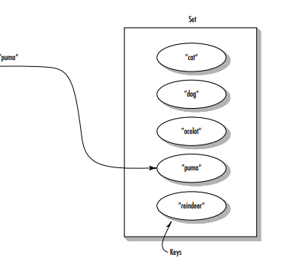
Set
Sets are often used to hold objects of user-defined classes such as employees in a database.
Sets can also hold simpler elements such as strings. The objects are arranged in order, and the entire object is the key.

Slide 68
Set – An example A set that stores objects of class string
#include <iostream>
#include <set>
#include <string>
using namespace std;
int main()
{ //array of string objects
string names[] = {“Juanita”, “Robert”,“Mary”, “Amanda”, “Marie”};
//initialize set to array
set<string,less<string>>nameSet(names,names+5);
//iterator to set
set<string, less<string> >::iterator iter;
nameSet.insert(“Yvette”); //insert more names
nameSet.insert(“Larry”);
nameSet.insert(“Robert”); //no effect; already in set nameSet.insert(“Barry”);
nameSet.erase(“Mary”); //erase a name
//display size of set
cout << “\nSize=” << nameSet.size() << endl;
iter = nameSet.begin(); //display members of set
while( iter != nameSet.end() )
cout << *iter++ << ‘\n’;
string searchName; //get name from user
cout << “\nEnter name to search for: “;
cin >> searchName;
//find matching name in set
iter = nameSet.find(searchName);
if( iter == nameSet.end() )
cout << “The name “<< searchName <<“ is NOT in the set.”;
else
cout << “The name “ << *iter << “ IS in the set.”;
cout << endl;
return 0;
}

Slide 69
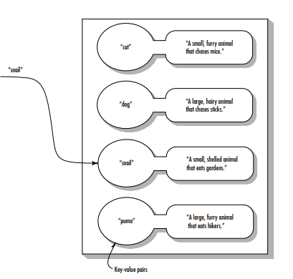
Map
A map stores pairs. A pair consists of a key object and a value object.
The key object contains a key that will be searched for. The value object contains additional data.
As in a set, the key objects can be strings, numbers, or objects of more complex classes. The values are often strings or numbers, but they can also be objects or even containers.

Slide 70
Map- An ex where keys will be the names of states, and the values will be the populations of the states
for(int j=0; j<6; j++)
{
name = states[j]; //get data from arrays
pop = pops[j];
mapStates[name] = pop; //put it in map
}
cout << “Enter state: “; //get state from user
cin >> name;
pop = mapStates[name]; //find population
cout << “Population: “ << pop << “,000\n”;
cout << endl; //display entire map
for(iter = mapStates.begin(); iter != mapStates.end(); iter++)
cout << (*iter).first << ‘ ‘ << (*iter).second << “,000\n”;
return 0;
}
#include <iostream>
#include <string>
#include <map>
using namespace std;
int main()
{
string name;
int pop;
string states[] = { “Wyoming”, “Colorado”, “Nevada”,
“Montana”, “Arizona”, “Idaho”};
int pops[] = { 470, 2890, 800, 787, 2718, 944 };
map<string, int, less<string> > mapStates; //map
map<string, int, less<string> >::iterator iter; //iterator

